Slide 1
RETAIL BANKING

Slide 2

INTRODUCTION
Retail Banking is generally refers to the offering of financial services, products related to deposits and assets to individual customers for personal consumption.
Banks concentrate on various segments like professionals, housewives, pensioner, salaried class etc
Different types of products like recurring deposits, saving bank deposits, fixed deposit, Credit cards, housing and consumer loan offered by banks of the above mentioned market segments.

Slide 3
PROBLEM STATEMENT
Every bank transaction needs to be recorded for future use.
This day-to-day transaction leads to creation of new data or modifying the existing data records.
To access and deal with their data, many organizations across industries primarily rely on Database Management Systems.
This brings the need of understanding the database tools and commands used to maintain a database management system in the banks.
In this study, we will be going through the creation and handling of database.

Slide 4

TECHNOLOGIES USED
Hardware specification:
CPU: Intel i5 64-bit x86 RAM: 4 GB
Display: 1024×768
Software requirement: Operating system: Windows 10 MySQL
MySQL Workbench 8.0 CE

Slide 5

SKILLS DEVELOPED / USED
1.
2.
3.
4.
5.
6.
7.
8.
Data Management
Data Definition Data Manipulation Critical Thinking Pattern Recognition Insights Creation Problem-Solving
Technical Skills - The technical skills used here are
Data Definition Language (DDL)
Data Manipulation Language (DML)
Joins
Views

Slide 6
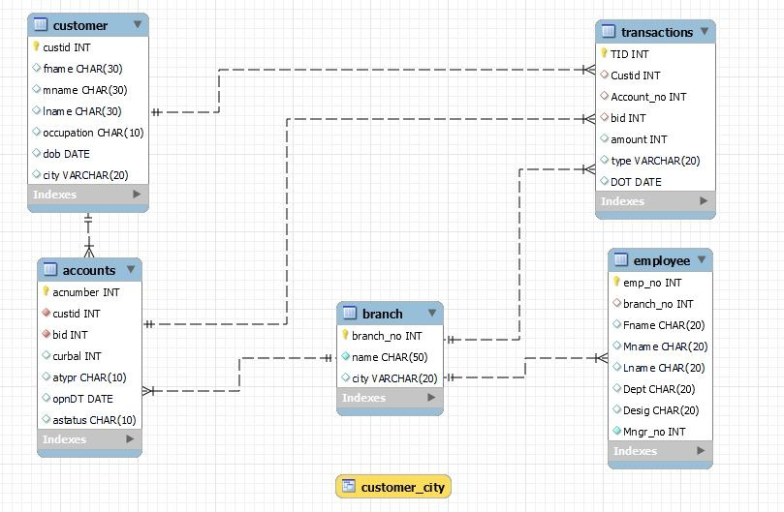
DATA DESCRIPTION

Slide 7
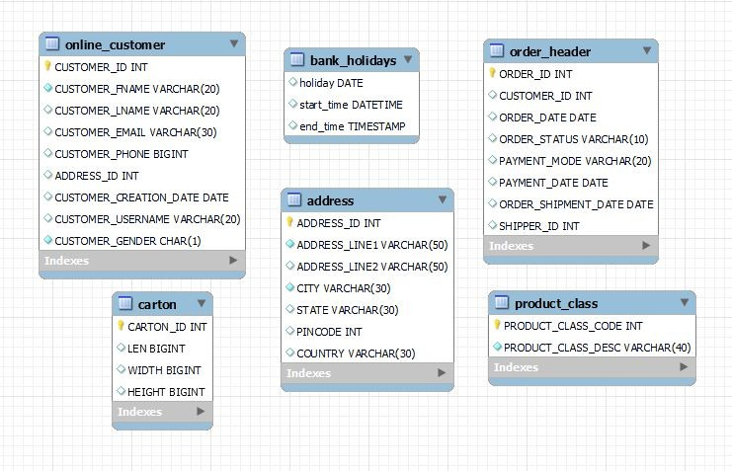

Slide 8
PROBLEM SOLVING STEPS
01
Creating a Database
02
Creation of tables
03
Connections between tables
04
Insertion of Values
05
Manipulation & Displaying of data
Before starting with any database related project, we need to create a database which can hold all the tables.
Tables are the containers which contains the data in rows and column form.
A database has multiple tables which have attributes connecting each other.So there is a need of making a connection between the tables.
Storing the data into the table under the desired attribute for future reference and manipulation.
Displaying the data required or changing the data when needed.

Slide 9
TAKEAWAYS & CONCLUSIONS
The project gave a basic understanding of how different database works.
As the importance of collecting, storing, and analyzing data increases day by day, the use of improved database management systems – especially those based in the cloud – will continue to help businesses perform Data Management tasks and achieve more productive results

Slide 10
DESCRIPTION
Description of Tables
Branch –Branch_no A system generated number
Name – Branch Location
Employees – Emp_no – A system generated number
Branch_no – A unique branch id (it must be present in Branch table)
Fname, Mname, Lname – First, middle and last name of employee
Dept – Employee’s department
Desig – Designation of employee
Mngr_no – Manager Id( must be present in employee table)
Status – status of account (active, suspended, Terminated)
Customers –
Cust_no – System Generated no
Fname, Mname, Lname - First, middle and last name of customer
City – city of customer
DoB_- Date of birth of customer
Occup – Occupation of customer
Accounts
Acc_no – A system generated no
Branch_no – A unique branch id (it must be present in Branch table)
Cust_no – customer no (must be present in customers table)
Type – type of account (CA (current) , SA (saving))
OpnDT – account open date
CurBal – Current balance

Slide 11
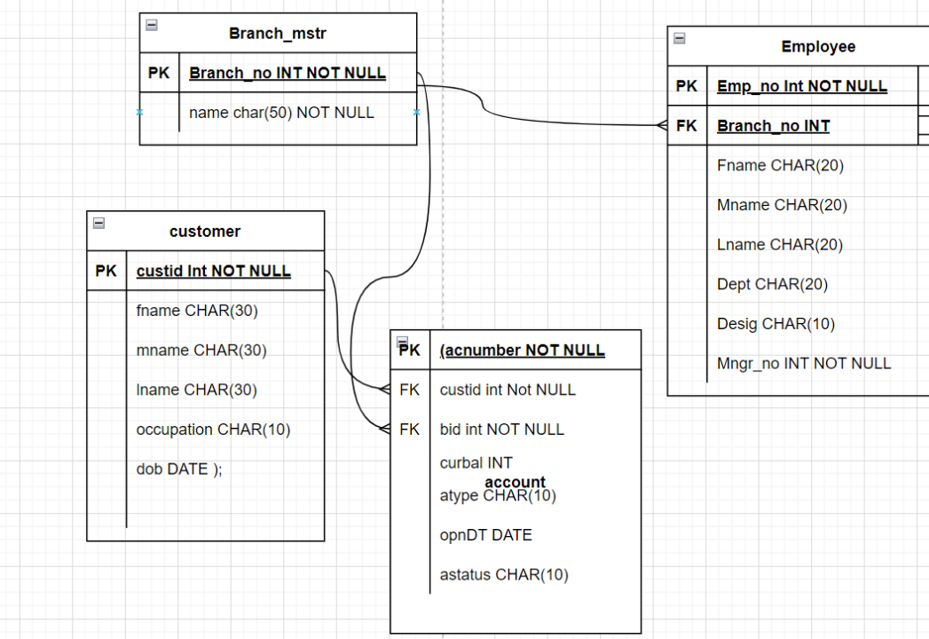
ENTITY RELATIONSHIP DIAGRAM:
Branch:
Branch_No | Name
1 | Delhi
2 | Mumbai
Customer
Custid | fname | mname | Lname | occupation | dob
1 | Ramesh | chandra | Sharma | Service | 1976-12-06
2 | Avinash | Sunder | Minha | Business | 1974-10-16

Slide 12
DATA GIVEN:
Account
acnumber | custid | bid | curbal | opnDT | atype | astatus
1 | 1 | 1 | 10000 | 15/12/12 | Saving | Active
2 | 2 | 2 | 5000 | 12/06/12 | Saving | Active
Employee
Emp_no | Branch_no | Fname | Mname | Lname | Dept | Desig |  | Mngr_no
1 | 1 |  | Mark | steve | Lara | Account | Accountant | 2
2 | 2 |  | Bella | James | Ronald | Loan | Manager |  | 1

Slide 13
QUESTION 1 :Create database bank and write sql query to create above schema with constraints
CREATE DATABASE Bank;
USE Bank;
CREATE TABLE Branch(
Branch_no INT NOT NULL PRIMARY KEY,
Name CHAR(50));
CREATE TABLE Employees(
Emp_no INT NOT NULL PRIMARY KEY,
Branch_no INT,
Fname CHAR (20),
Mname CHAR (20),
Lname CHAR (20),
Dept CHAR (20),
Desig CHAR (10),
Mngr_no INT NOT NULL);
ALTER TABLE Employees ADD FOREIGN KEY (Branch_no)
REFERENCES Branch(Branch_no);
CREATE TABLE Customers(
Cust_id INT NOT NULL PRIMARY KEY,
Fname CHAR (30),
Mname CHAR (30),
Lname CHAR (30),
City CHAR (20),
DoB DATE,
Occup CHAR (10));
CREATE TABLE Accounts(
Acc_no INT NOT NULL PRIMARY KEY,
Branch_no INT NOT NULL,
Cust_id INT NOT NULL,
AccType CHAR (10),
OpnDT DATE,
CurBal INT,
AccStatus CHAR (10));
ALTER TABLE Accounts ADD FOREIGN KEY (Cust_id)
REFERENCES Customers(Cust_id);
ALTER TABLE Accounts ADD FOREIGN KEY (Branch_no)
REFERENCES Branch(Branch_no);

Slide 14
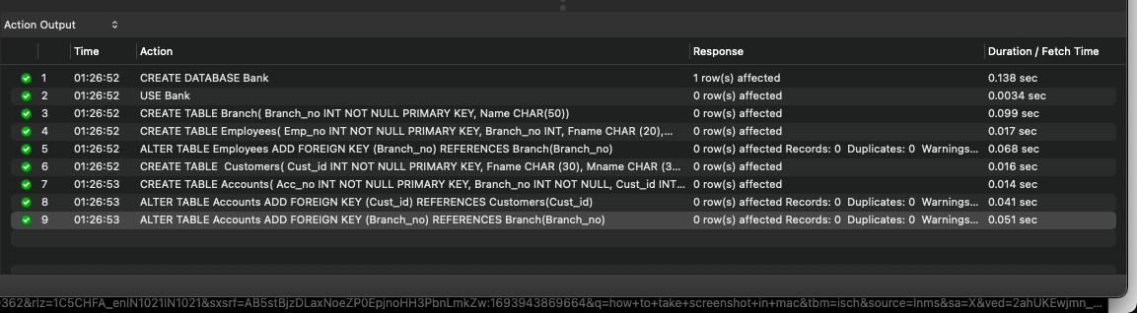
Output:

Slide 15
CODE BREAKDOWN:
Creating a database with the name Bank and
creating a schema with the above constraints which are
Table name: Branch with Int datatype for branch_no column , char(string) datatype for Name column
Table name: Customer with int datatype for custid column , fname,lname,mname with char datatype
city with char datatype , dob with date datatype and occup with char datatype
Table name: Employees with emp_no for employee number with int datatype and as a primary key ,
branch_no with int datatype, fname, mname, lname (first name, middle name , last name) with char datatype
dept and desig with char datatype , mngr_no with int datatype
Table name : Accounts with acc_no as column name with int datatype , branch_no with int datatype,
cust_no with int datatype, Acc_type with CHAR datatype , OpnDT with DATE datatype , CurBal with INT,
AccStatus with CHAR datatype
Employees and Branch has a foreign key linked to each other with branch_no being the foreign key
Link accounts table and customers table using foreign key Cust_no and branch_id.

Slide 16
QUESTION 2. Inserting Records into created tables
INSERT INTO branch(Branch_no, Name)
VALUES (1, 'Delhi'),
(2, 'Mumbai');
INSERT INTO Customers (cust_id, fname, mname, lname, occup, dob)
VALUES (1, 'Ramesh', 'Chandra', 'Sharma', 'Service', '1976-12-06'),
(2, 'Avinash', 'Sunder', 'Minha', 'Business', '1974-10-16');
INSERT INTO Accounts (acc_no, cust_id, Branch_no, curbal, opnDT, AccType, AccStatus)
VALUES (1, 1, 1, 10000, '2012-12-15', 'Saving', 'Active'),
(2, 2, 2, 5000, '2012-06-12', 'Saving', 'Active');
SELECT * FROM accounts;
INSERT INTO Employees (Emp_no, Branch_no, Fname, Mname, Lname, Dept, Desig, Mngr_no)
VALUES (1, 1, 'Mark', 'steve', 'Lara', 'Account', 'Accountant', 2),
(2, 2, 'Bella', 'James', 'Ronald', 'Loan', 'Manager', 1);
CODE BREAKDOWN:
Adding values into the table using INSERT INTO , VALUES Keyword.

Slide 17
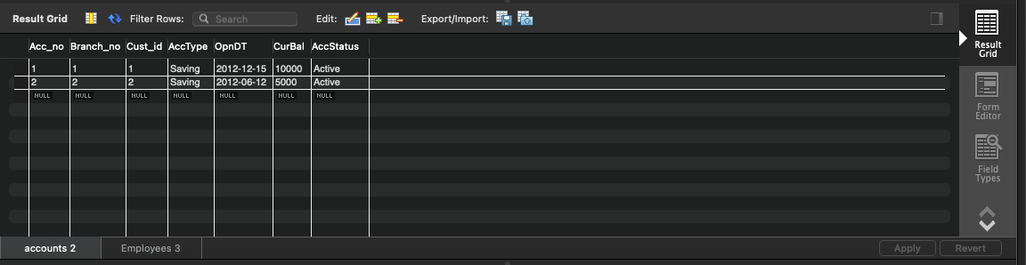
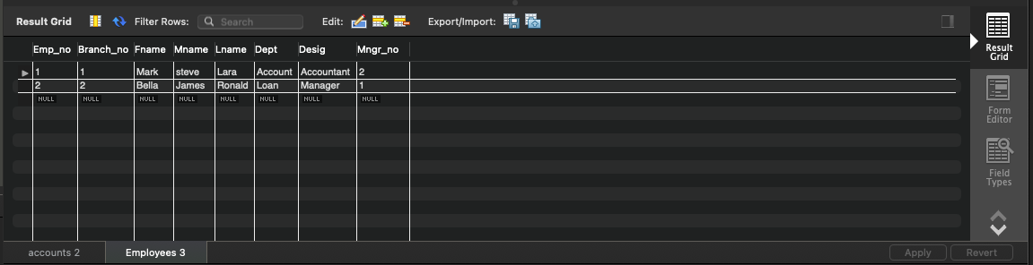
OUTPUT:

Slide 18
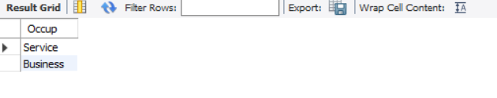
QUESTION 3: Select unique occupation from customer table
ANSWER:
SELECT DISTINCT Occup FROM customers;
CODE BREAK DOWN:
For selecting unique occupation column values we can use the DISTINCT keyword */
OUTPUT:

Slide 19
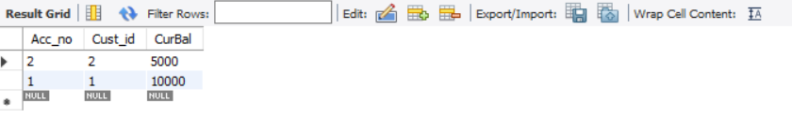
QUESTION 4: Sort accounts according to current balance
ANSWER:
SELECT Acc_no, Cust_id, CurBal FROM accounts
ORDER BY CurBal;
CODE BREAKDOWN:
For sorting accounts according to current balance we use ORDER BY keyword
Selecting Account number , customer id , current balance from accounts table and ordering the data by current balance.
OUTPUT:

Slide 20
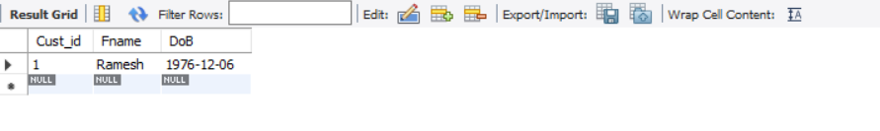
QUESTION 5: Find the Date of Birth of customer name ‘Ramesh’
ANSWER:
SELECT Cust_id, Fname, DoB FROM customers
WHERE Fname = 'Ramesh’;
CODE BREAKDOWN:
Selecting customer id , first name and date of birth (data required to show) from customers table and filtering the data
using WHERE clause to find the date of birth of Ramesh.
OUTPUT:

Slide 21
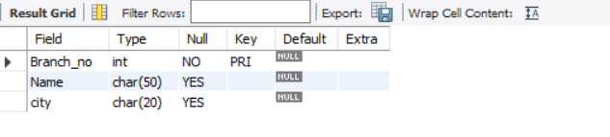
QUESTION 6. Add column city to branch table
ANSWER :
ALTER TABLE branch
ADD COLUMN city CHAR(20);
CODE BREAKDOWN:
To add column we use ALTER TABLE , ADD COLUMN Keyword, so for branch table we add the column city which has a datatype of CHAR.
OUTPUT:

Slide 22
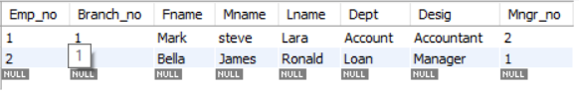
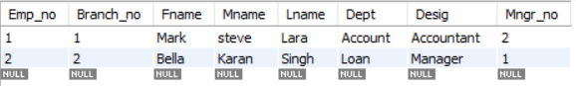
QUESTION 7. Update the mname and lname of employee ‘BELLA’ and set to ‘KARAN’, ‘SINGH’
ANSWER:
SELECT * FROM employees;
SET sql_safe_updates = 0;
UPDATE employees
SET mname = 'Karan', lname = 'Singh'
WHERE Fname = 'Bella’;
CODE BREAKDOWN:
To change the values of a column we use UPDATE keyword along with SET keyword.So after selecting all columns from employees table UPDATE the employees table by SETing the column values to new values using WHERE condition to select the columns to change the functionality.In this question we are setting the middle name as 'karan' and last name as 'singh' under the condition that the first name is 'Bella’.
OUTPUT:

Slide 23
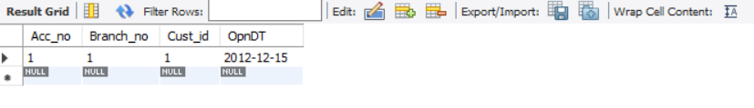
QUESTION 8. Select accounts opened between '2012-07-01' AND '2013-01-01'
ANSWER:
SELECT * FROM accounts;
SELECT Acc_no, Branch_no, Cust_id, OpnDT FROM accounts
WHERE OpnDT BETWEEN '2012-07-01' AND '2013-01-01’;
CODE BREAKDOWN:
In this question the essential columns are Acc_no, Branch_no, Cust_id, OpnDT which are present in Accounts table, to access the time constraint we use WHERE keyword to keep a condition where the time is BETWEEN the two given dates.
OUTPUT:

Slide 24
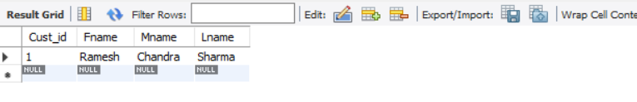
QUESTION 9. List the names of customers having ‘a’ as the second letter in their names
ANSWER:
SELECT Cust_id, Fname, Mname, Lname FROM customers
WHERE Fname LIKE '_a%’;
CODE BREAKDOWN:
For this question the second letter of the first name has to be 'a' so '_' keyword which denotes a single character whereas '%' denotes many characters so '_a%' means Any first letter should be followed by 'a’ and any other characters.
OUTPUT:

Slide 25
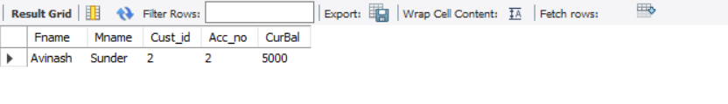
QUESTION 10.Find the lowest balance from customer and account table
ANSWER:
SELECT a.Fname, a.Mname, b.Cust_id, b.Acc_no, b.CurBal
FROM customers a
INNER JOIN accounts b
ON a.cust_id = b.cust_id
ORDER BY b.CurBal
LIMIT 1;
CODE BREAKDOWN:
/*To find the lowest balance we join the tables customers and accounts. Inner join is used because it gives the common elements, and ON keyword is used to represent the column which is same(key) for two tables. ORDER BY is used to order the data of current balance in ascending order and LIMIT keyword is used to limit the number of rows.
OUTPUT:

Slide 26
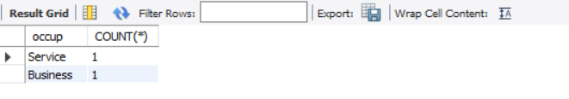
QUESTION 11. Give the count of customer for each occupation
ANSWER:
SELECT occup, COUNT(*) FROM customers
GROUP BY occup;
CODE BREAKDOWN:
The SELECT statement is used to retrieve data from the database. The occup column and the COUNT(*) function are selected in the query. The FROM clause specifies the table customers from which the data is retrieved. The GROUP BY clause groups the data by the occup column.
OUTPUT:

Slide 27
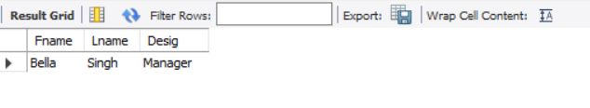
QUESTION 12. Write a query to find the name (first_name, last_name) of the employees who are managers.
ANSWER:
SELECT * FROM employees;
SELECT Fname, Lname, Desig FROM employees
WHERE desig = ‘Manager’;
CODE BREAKDOWN:
This statement selects all columns from the "employees" table. The asterisk (*) is used as a wildcard to select all columns. This statement selects the "Fname", "Lname", and "Desig" columns from the "employees" table. The condition "WHERE desig = 'Manager'" is applied to filter the results. Only the rows where the "Desig" column has the value 'Manager' will be returned.
OUTPUT:

Slide 28
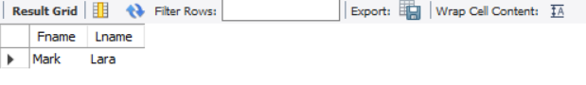
QUESTION 13. List name of all employees whose name ends with a
ANSWER:
SELECT Fname, Lname FROM employees
WHERE Lname LIKE '%a’;
CODE BREAKDOWN:
The SQL statement selects the columns Fname and Lname from the table employees. The WHERE clause is used to filter the results based on the condition Lname LIKE '%a', which means that only the rows where the Lname column ends with the letter 'a' will be returned. The % symbol is a wildcard character that represents any number of characters, so the condition Lname LIKE '%a' will match any value in the Lname column that ends with the letter 'a'
OUTPUT:

Slide 29
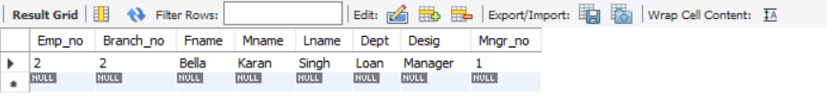
QUESTION 14. Select the details of the employee who work either for department ‘loan’ or ‘credit’
ANSWER:
SELECT * FROM employees;
SELECT * FROM employees
WHERE Dept = 'loan' OR 'credit’;
CODE BREAKDOWN:
The SQL statement selects all columns from the "employees" table. The WHERE clause filters the results to only include rows where the "Dept" column is either 'loan' or 'credit'. The OR operator is used to specify that either condition can be true for a row to be included in the result.
OUTPUT:

Slide 30
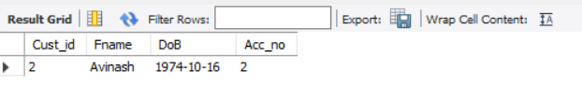
QUESTION 15. Write a query to display the customer number, customer firstname, account number for the customer’s who are born after 15th of any month.
ANSWER:
SELECT a.Cust_id, a.Fname, a.DoB, b.Acc_no
FROM customers a
JOIN accounts b
ON a.Cust_id = b.Cust_id
WHERE DATE_FORMAT(a.DoB, '%d') > 15;
CODE BREAKDOWN:
The SQL statement selects the columns Cust_id, Fname, DoB, and Acc_no from the tables customers and accounts.The JOIN clause is used to combine the two tables based on the Cust_id column.The WHERE clause filters the results to only include rows where the day of the DoB column is greater than 15 of any month.
OUTPUT:

Slide 31
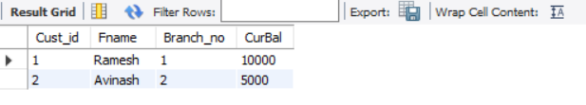
QUESTION 16. Write a query to display the customer’s number, customer’s firstname, branch id and balance amount for people using JOIN.
ANSWER:
SELECT a.Cust_id, a.Fname, b.Branch_no, b.CurBal
FROM customers a
JOIN accounts b
ON a.Cust_id = b.Cust_id;
CODE BREAKDOWN:
The statement selects the Cust_id, Fname, Branch_no, and CurBal columns from the customers and accounts tables. The JOIN keyword is used to combine the customers and accounts tables based on the matching Cust_id column. The result will include the Cust_id and Fname from the customers table, and the Branch_no and CurBal from the accounts table.
OUTPUT:

Slide 32
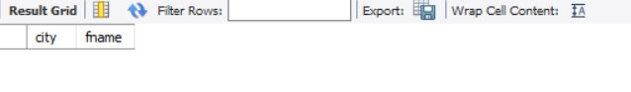
QUESTION 17. Create a virtual table to store the customers who are having the accounts in the same city as they live
ANSWER:
CREATE VIEW acc_in_same_city AS
SELECT a.city, b.fname FROM branch a
JOIN customers b
ON a.city = b.city
WHERE a.city IS NOT NULL;
CODE BREAKDOWN:
The CREATE VIEW statement is used to create a view named acc_in_same_city.The SELECT statement retrieves the city column from the branch table and the fname column from the customers table.The JOIN clause is used to combine the branch and customers tables based on the matching city values.The WHERE clause filters out any rows where the city in the branch table is NOT NULL.
OUTPUT:

Slide 33
QUESTION 18 : Create a transaction table with following details
TID – transaction ID – Primary key with autoincrement
Custid – customer id (reference from customer table)
account no – account number (references account table)
bid – Branch id – references branch table
amount – amount in numbers
type – type of transaction (Withdraw or deposit)
DOT - date of transaction
ANSWER:
CREATE TABLE transaction
(TID INT PRIMARY KEY AUTO_INCREMENT,
Cust_id INT,
Acc_no INT,
Branch_no INT,
amount DECIMAL(10, 2),
trans_type CHAR(10),
DOT DATE);
ALTER TABLE transaction ADD FOREIGN KEY (Cust_id) REFERENCES Customers (Cust_id);
ALTER TABLE transaction ADD FOREIGN KEY (Acc_no) REFERENCES accounts (Acc_no);
ALTER TABLE transaction ADD FOREIGN KEY (Branch_no) REFERENCES branch (Branch_no);

Slide 34
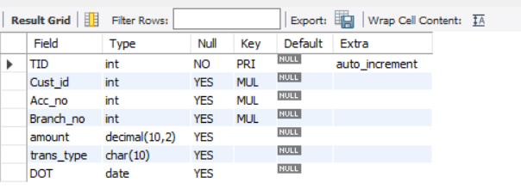
CODE BREAKDOWN:
The SQL statement creates a table named "transaction" with the specified columns and data types.The "TID" column is defined as an integer primary key with auto-increment, which means its value will be automatically generated and incremented by 1 for each new row. The other columns include "Cust_id" (integer), "Acc_no" (integer), "Branch_no" (integer),"amount" (decimal with precision 10 and scale 2), "trans_type" (character with length 10), and "DOT" (date). Assigning foreign key using ALTER TABLE keyword and ADD FOREIGN KEY with REFERENCES by refering the table and same column name.
OUTPUT:

Slide 35
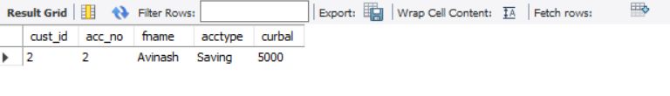
QUESTION 19. Write a query to display the details of customer with second highest balance.
ANSWER:
SELECT a.cust_id, b.acc_no, a.fname, b.acctype, b.curbal
FROM customers a
JOIN accounts b
ON a.cust_id = b.cust_id
ORDER BY 5 DESC LIMIT 1 OFFSET 1;
CODE BREAKDOWN:
The statement selects the cust_id, acc_no, fname, acctype, and curbal columns from the customers and accounts tables.It joins the customers and accounts tables on the cust_id column.The result is ordered by the curbal column in descending order, and then it selects the second row using LIMIT 1 OFFSET 1.
OUTPUT:

Slide 36
CREATING A DATABASE CASESTUDY
CREATE DATABASE casestudy;
USE casestudy;
CREATE TABLE ADDRESS
(ADDRESS_ID INT(6),
ADDRESS_LINE1 VARCHAR(50),
ADDRESS_LINE2 VARCHAR(50), \
CITY VARCHAR(30),
STATE VARCHAR(30),
PINCODE INT(6),
COUNTRY VARCHAR(30)) ;
CREATE TABLE CARTON
(CARTON_ID INT(6),
LEN BIGINT(10),
WIDTH BIGINT(10),
HEIGHT BIGINT(10)) ;
CREATE TABLE ONLINE_CUSTOMER (CUSTOMER_ID INT(6),
CUSTOMER_FNAME VARCHAR(20),
CUSTOMER_LNAME VARCHAR(20),
CUSTOMER_EMAIL VARCHAR(30),
CUSTOMER_PHONE BIGINT(10),
ADDRESS_ID INT(6),
CUSTOMER_CREATION_DATE DATE,
CUSTOMER_USERNAME VARCHAR(20),
CUSTOMER_GENDER CHAR(1)) ;
CREATE TABLE ORDER_HEADER
(ORDER_ID INT(6),
CUSTOMER_ID INT(6),
ORDER_DATE DATE,
ORDER_STATUS VARCHAR(10),
PAYMENT_MODE VARCHAR(20),
PAYMENT_DATE DATE,
ORDER_SHIPMENT_DATE DATE,
SHIPPER_ID INT(6)) ;

Slide 37
.
CREATE TABLE ORDER_ITEMS
(ORDER_ID INT(6),
PRODUCT_ID INT(6),
PRODUCT_QUANTITY INT(3)) ;
CREATE TABLE PRODUCT
(PRODUCT_ID INT(6),
PRODUCT_DESC VARCHAR(60),
PRODUCT_CLASS_CODE INT(4),
PRODUCT_PRICE DECIMAL(12,2),
PRODUCT_QUANTITY_AVAIL INT(4),
LEN INT(5),
WIDTH INT(5),
HEIGHT INT(5),
WEIGHT DECIMAL(10,4)) ;
CREATE TABLE PRODUCT_CLASS
(PRODUCT_CLASS_CODE INT(4),
PRODUCT_CLASS_DESC VARCHAR(40)) ;
CREATE TABLE SHIPPER
(SHIPPER_ID INT(6),
SHIPPER_NAME VARCHAR(30),
SHIPPER_PHONE BIGINT(12),
SHIPPER_ADDRESS INT(6)) ;

Slide 38
ADDING CONSTRAINTS:
CREATE UNIQUE INDEX addr_id_indx ON ADDRESS (ADDRESS_ID);
CREATE UNIQUE INDEX CARTON_PK ON CARTON (CARTON_ID);
CREATE UNIQUE INDEX online_custid_indx ON ONLINE_CUSTOMER (CUSTOMER_ID);
CREATE UNIQUE INDEX online_email_indx ON ONLINE_CUSTOMER (CUSTOMER_EMAIL) ;
CREATE UNIQUE INDEX PK_ORD_H ON ORDER_HEADER (ORDER_ID) ;
CREATE UNIQUE INDEX PK_ORD_PROD ON ORDER_ITEMS (ORDER_ID, PRODUCT_ID) ;
CREATE UNIQUE INDEX PK_PROD ON PRODUCT (PRODUCT_ID)
CREATE UNIQUE INDEX PK_PROD_CLASS ON PRODUCT_CLASS (PRODUCT_CLASS_CODE) ;
CREATE UNIQUE INDEX PK_SHIP_ID ON SHIPPER (SHIPPER_ID)
Constraints for Table ADDRESS
ALTER TABLE ADDRESS MODIFY ADDRESS_LINE1 VARCHAR(50) NOT NULL;
ALTER TABLE ADDRESS ADD PRIMARY KEY (ADDRESS_ID);
ALTER TABLE ADDRESS MODIFY CITY VARCHAR(30) NOT NULL;
Constraints for Table CARTON
ALTER TABLE CARTON ADD CONSTRAINT CARTON_PK PRIMARY KEY (CARTON_ID);

Slide 39
.
Constraints for Table ONLINE_CUSTOMER
ALTER TABLE ONLINE_CUSTOMER MODIFY CUSTOMER_GENDER CHAR(1) NOT NULL ;
ALTER TABLE ONLINE_CUSTOMER MODIFY CUSTOMER_FNAME VARCHAR(20) NOT NULL ;
ALTER TABLE ONLINE_CUSTOMER ADD PRIMARY KEY (CUSTOMER_ID);
ALTER TABLE ONLINE_CUSTOMER ADD UNIQUE (CUSTOMER_EMAIL;
Constraints for Table ORDER_HEADER
ALTER TABLE ORDER_HEADER ADD CONSTRAINT PK_ORD_H PRIMARY KEY (ORDER_ID);
Constraints for Table ORDER_ITEMS
ALTER TABLE ORDER_ITEMS ADD CONSTRAINT PK_ORD_PROD PRIMARY KEY (ORDER_ID, PRODUCT_ID);
Constraints for Table PRODUCT
ALTER TABLE PRODUCT ADD CONSTRAINT PK_PROD PRIMARY KEY (PRODUCT_ID);
Constraints for Table PRODUCT_CLASS
ALTER TABLE PRODUCT_CLASS ADD CONSTRAINT PK_PROD_CLASS PRIMARY KEY (PRODUCT_CLASS_CODE);
ALTER TABLE PRODUCT_CLASS MODIFY PRODUCT_CLASS_DESC VARCHAR(40) NOT NULL ;
Constraints for Table SHIPPER
ALTER TABLE SHIPPER ADD CONSTRAINT PK_SHIP_ID PRIMARY KEY (SHIPPER_ID);
ALTER TABLE SHIPPER MODIFY SHIPPER_NAME VARCHAR(40) NOT NULL;
ALTER TABLE SHIPPER MODIFY SHIPPER_PHONE DECIMAL (10,0) NOT NULL

Slide 40
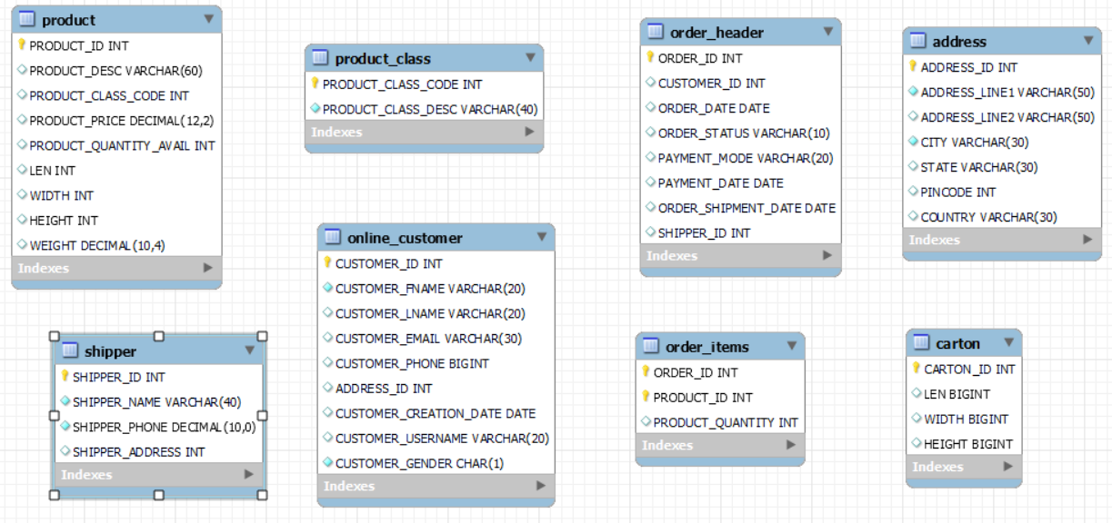

Slide 41
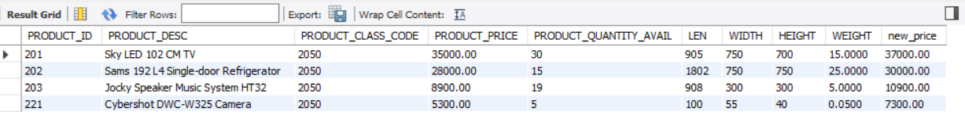
Question 1. Display the product details as per the following criteria and sort them in descending order of category: a. If the category is 2050, increase the price by 2000
ANSWER:
SELECT *, (product_price + 2000) new_price FROM product
WHERE product_class_code = 2050
ORDER BY new_price DESC;
CODE BREAKDOWN:
It selects all columns from the product table using SELECT *.It calculates a new price by adding 2000 to the product_price column, and names this new calculated value as new_price.It filters the results to include only rows where the product_class_code is equal to 2050.It sorts the results in descending order based on the calculated new_price.
OUTPUT:

Slide 42
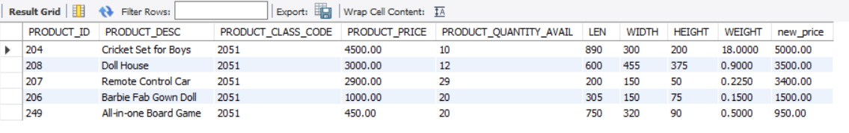
b. If the category is 2051, increase the price by 500
ANSWER:
SELECT *, (product_price + 500) new_price FROM product
WHERE product_class_code = 2051
ORDER BY new_price DESC;
CODE BREAKDOWN:
It selects all columns from the product table using SELECT *.It calculates a new price by adding 500 to the product_price column, and names this new calculated value as new_price.It filters the results to include only rows where the product_class_code is equal to 2051.It sorts the results in descending order based on the calculated new_price.
OUTPUT:

Slide 43
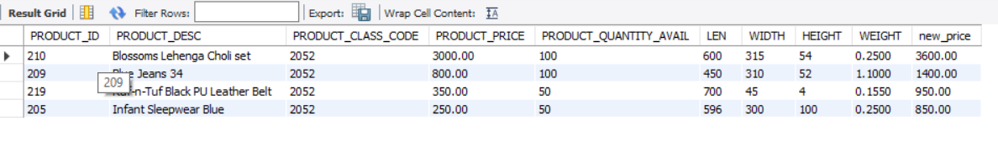
c. If the category is 2052, increase the price by 600
ANSWER:
SELECT *, (product_price + 600) new_price FROM product
WHERE product_class_code = 2052
ORDER BY new_price DESC;
CODE BREAKDOWN:
It selects all columns from the product table using SELECT *.It calculates a new price by adding 600 to the product_price column, and names this new calculated value as new_price.It filters the results to include only rows where the product_class_code is equal to 2052.It sorts the results in descending order based on the calculated new_price.
OUTPUT:

Slide 44
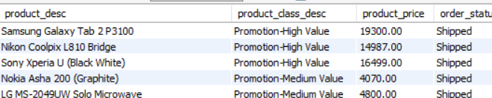
2. List the product description, class description and price of all products which are shipped.
ANSWER:
SELECT a.product_desc, b.product_class_desc, a.product_price, c.order_status
FROM product a
JOIN product_class b
ON a.product_class_code = b.product_class_code
JOIN order_header c
WHERE c.order_status = 'shipped';
CODE BREAKDOWN:
We're selecting columns from three tables: product, product_class, and order_header.We use JOIN to combine the product table with the product_class table based on the common column product_class_code.We also use another JOIN to link the product table with the order_header table based on the common column product_id.The WHERE clause filters the results to include only those rows where the order_status is 'shipped'.
OUTPUT:

Slide 45
3. Show inventory status of products as below as per their available quantity: a. For Electronics and Computer categories, if available quantity is < 10, show 'Low stock', 11 < qty < 30, show 'In stock', > 31, show 'Enough stock'
ANSWER:
SELECT DISTINCT a.product_class_desc, b.product_quantity_avail, CASE
WHEN product_class_desc IN ('Electronics', 'Computer') AND product_quantity_avail < 11 THEN 'Low Stock‘
WHEN product_class_desc IN ('Electronics', 'Computer') AND product_quantity_avail BETWEEN 11 AND 30 THEN 'In Stock‘
WHEN product_class_desc IN ('Electronics', 'Computer') AND product_quantity_avail > 30 THEN 'Enough Stock‘
WHEN product_class_desc IN ('Electronics', 'Computer') AND product_quantity_avail = 0 THEN 'Out Of stock‘
END AS 'inventory status'FROM product_class a
JOIN product b
ON a.product_class_code = b.product_class_code
WHERE product_class_desc IN ('Electronics', 'Computer');

Slide 46
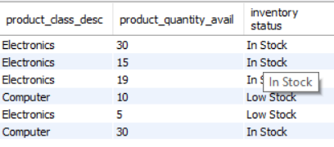
CODE BREAKDOWN:
We've expanded the CASE statement to handle the new inventory status conditions and categories. The ELSE part of the CASE statement now covers all other categories.For each category, we have nested CASE statements to check different quantity ranges and assign the appropriate status labels.This query now covers the entire spectrum of inventory status for all categories, including different quantity ranges and the 'Out of stock' condition.
We're selecting relevant columns from the product, product_class, and inventory tables.The CASE statement is used to determine the inventory_status based on the conditions specified. For products belonging to the 'Electronics' and 'Computer' categories with available quantity less than 10, the status will be 'Low stock',with available quantity between 11 to 30, the status will be 'In stock', greater than 30, it will be enough stock and if the available quantity is 0 assign 'Out of stock' status.
OUTPUT:

Slide 47
b. For Stationery and Clothes categories, if qty < 20, show 'Low stock', 21 < qty < 80, show 'In stock', > 81, show 'Enough stock'
ANSWER:
SELECT DISTINCT a.product_class_desc, b.product_quantity_avail, CASE
WHEN product_class_desc IN ('Stationery', 'Clothes') AND product_quantity_avail < 20 THEN 'Low stock‘
WHEN product_class_desc IN ('Stationery', 'Clothes') AND product_quantity_avail BETWEEN 20 AND 80 THEN 'In stock‘
WHEN product_class_desc IN ('Stationery', 'Clothes') AND product_quantity_avail > 81 THEN 'Enough stock‘
WHEN product_class_desc IN ('Stationery', 'Clothes') AND product_quantity_avail = 0 THEN 'Out Of stock‘
END AS 'inventory status‘ FROM product_class a
JOIN product b
ON a.product_class_code = b.product_class_code
WHERE product_class_desc IN ('Stationery', 'Clothes');
CODE BREAKDOWN:
We're using a nested CASE statement within the outer CASE statement. The inner CASE statement checks the available quantity for products in the 'Stationery' and 'Clothes' categories and assigns the appropriate status labels based on the specified ranges.The outer CASE statement is similar to the previous version.For products belonging to the 'Stationery' and 'Clothes' categories with available quantity less than 20, the status will be 'Low stock',with available quantity between 20 to 80, the status will be 'In stock', greater than 81, it will be enough stock and if the available quantity is 0 assign 'Out of stock' status

Slide 48
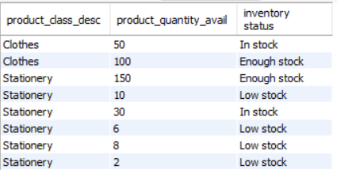
OUTPUT:
.

Slide 49
c. Rest of the categories, if qty < 15 – 'Low Stock', 16 < qty < 50 – 'In Stock', > 51 – 'Enough stock‘. For all categories, if available quantity is 0, show 'Out of stock'.
ANSWER:
SELECT DISTINCT a.product_class_desc, b.product_quantity_avail, CASE
WHEN product_class_desc NOT IN ('Electronics', 'Computer', 'Stationery', 'Clothes') AND product_quantity_avail < 16 THEN 'Low stock‘
WHEN product_class_desc NOT IN ('Electronics', 'Computer', 'Stationery', 'Clothes') AND product_quantity_avail BETWEEN 16 AND 50 THEN 'In stock‘
WHEN product_class_desc NOT IN ('Electronics', 'Computer', 'Stationery', 'Clothes') AND product_quantity_avail > 51 THEN 'Enough stock‘
WHEN product_class_desc NOT IN ('Electronics', 'Computer', 'Stationery', 'Clothes') AND product_quantity_avail = 0 THEN 'Out Of stock‘
END AS 'inventory status‘ FROM product_class a
JOIN product bON a.product_class_code = b.product_class_code
WHERE product_class_desc NOT IN ('Electronics', 'Computer', 'Stationery', 'Clothes');

Slide 50
CODE BREAKDOWN:
SELECT DISTINCT a.product_class_desc, b.product_quantity_avail, ... AS 'inventory status'This part of the query selects distinct product class descriptions and the available quantity for products within those classes. It also uses the CASE statement to assign inventory status based on the specified conditions.
WHEN product_class_desc NOT IN ('Electronics', 'Computer', 'Stationery', 'Clothes') AND product_quantity_avail < 16 then status will be 'Low stock'. This condition checks if the product class description is not one of the specified categories and if the available quantity is less than 16. If both conditions are met, it assigns the status 'Low stock'.
WHEN product_class_desc NOT IN ('Electronics', 'Computer', 'Stationery', 'Clothes') AND product_quantity_avail BETWEEN 16 AND 50 then the status will be 'In stock‘. This condition checks if the product class description is not in the specified categories and if the available quantity is between 16 and 50 (inclusive). If both conditions are met, it assigns the status 'In stock'.
WHEN product_class_desc NOT IN ('Electronics', 'Computer', 'Stationery', 'Clothes') AND product_quantity_avail > 51 THEN 'Enough stock'This condition checks if the product class description is not in the specified categories and if the available quantity is greater than 51. If both conditions are met, it assigns the status 'Enough stock'.
WHEN product_class_desc NOT IN ('Electronics', 'Computer', 'Stationery', 'Clothes') AND product_quantity_avail = 0 THEN 'Out Of stock'This condition checks if the product class description is not in the specified categories and if the available quantity is 0. If both conditions are met, it assigns the status 'Out of stock'.
FROM product_class a JOIN product b ON a.product_class_code = b.product_class_code. This part of the query performs an inner join between the product_class table (aliased as a) and the product table (aliased as b) using the product_class_code as the linking column.
WHERE product_class_desc NOT IN ('Electronics', 'Computer', 'Stationery', 'Clothes')This WHERE clause filters out the specified categories (Electronics, Computer, Stationery, Clothes), ensuring that the inventory status calculation applies only to other categories.
Overall, this query provides a comprehensive breakdown of the inventory status for product classes outside the specified categories, considering different quantity ranges and 'Out of stock' scenarios.

Slide 51
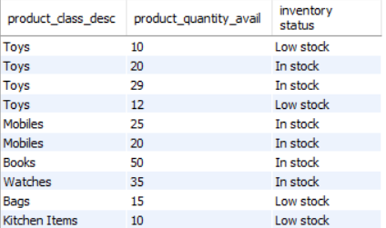
OUTPUT:

Slide 52
4. List customers from outside Karnataka who haven’t bought any toys or books
ANSWER:
SELECT DISTINCT a.customer_id, a.customer_fname
FROM online_customer a
JOIN address b
ON a.address_id = b.address_id
JOIN product_class c
WHERE b.city != 'Karnataka' AND product_class_desc NOT IN ('toys', 'books');
CODE BREAKDOWN:
We're selecting distinct customer_id and customer_fname columns from the online_customer table.We use a LEFT JOIN with address table and product class table to gather info about city and product class description.The JOIN conditions link the relevant tables based on their respective IDs and codes.The WHERE clause filters the results to include customers from outside Karnataka (b.state != 'Karnataka') who haven't bought any toys or books. The condition (c.product_class_desc NOT IN ('toys', 'books')) ensures that customers who haven't bought any productsor have bought products other than toys or books are included.

Slide 53
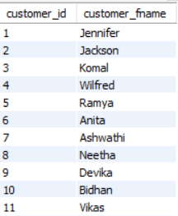
OUTPUT:

Slide 54
THANK YOU

